Slide 1


MICROSOFT COPILOT AND AGENTS

Slide 2

Module Agenda
Introduction to Agents
AI Agents capabilities
AI Agents Use Cases in Business
Demo 1: Use Existing Agents in CoPilot
Demo 2: Create a new CoPilot Agent
Demo 3: Create a new CoPilot Agent in SharePoint
© All rights reserved for Dr. Ryan Ahmed @Stemplicity Inc.

Slide 3
INTRODUCTION TO AGENTS

Slide 4
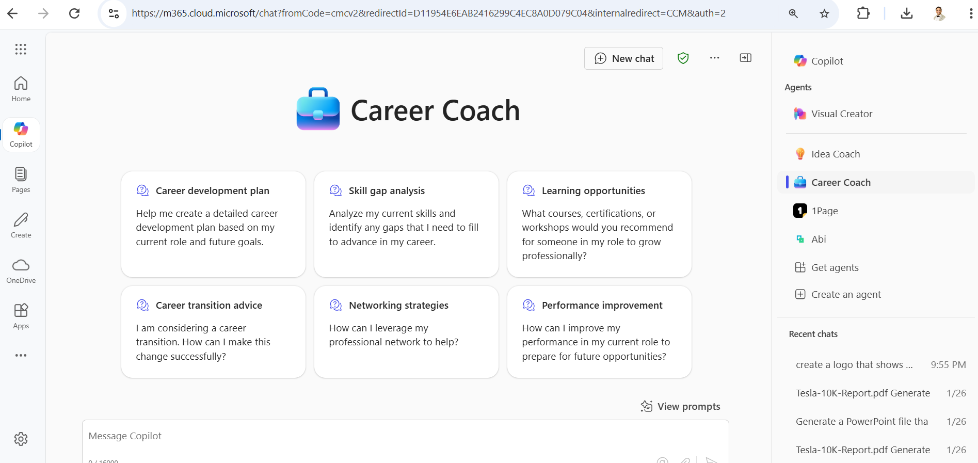
Introduction to Agents in CoPilot
AI agents are advanced systems that can autonomously perform tasks, ranging from simple responses to complex, multi-step processes.
They can be customized for specific expertise and operate independently or alongside humans.
You can use existing Agents or create new agents without coding!
© All rights reserved for Dr. Ryan Ahmed @Stemplicity Inc.
“Think of agents as the new apps for an AI-powered world”, Jared Spataro, Microsoft’s chief marketing officer for AI at Work

Slide 5
Capabilities and Benefits
Capabilities: Beyond assisting, AI agents can execute entire workflows, such as reconciling financial statements or managing project tasks, enhancing efficiency and productivity.
Integration with Tools: Integrating AI agents with platforms like Microsoft 365 Copilot allows for seamless handling of various tasks, from daily administrative duties to initiating creative projects.
Benefits: By delegating routine or complex tasks to AI agents, employees can focus on strategic initiatives, leading to increased productivity and the ability to achieve more within organizations.
© All rights reserved for Dr. Ryan Ahmed @Stemplicity Inc.

Slide 6
AI Agents Business use Cases
Project Management:
Copilot agents can compile updates from team members, identify key milestones and potential roadblocks and write progress reports.
Customer Support:
Agents quickly scan through vast information to find solutions from previous support tickets and draft responses to customer queries.
Research and Development
Agents scan the latest research papers, patents, and industry trends, presenting information concisely.
Sales and Marketing
By examining a client's business & competitors, agents deliver insightful analyses to inform sales strategies.
Human Resources
Agents can write handbooks to ensure compliance with regulations and new policies.
© All rights reserved for Dr. Ryan Ahmed @Stemplicity Inc.

Slide 7
DEMO

Slide 8
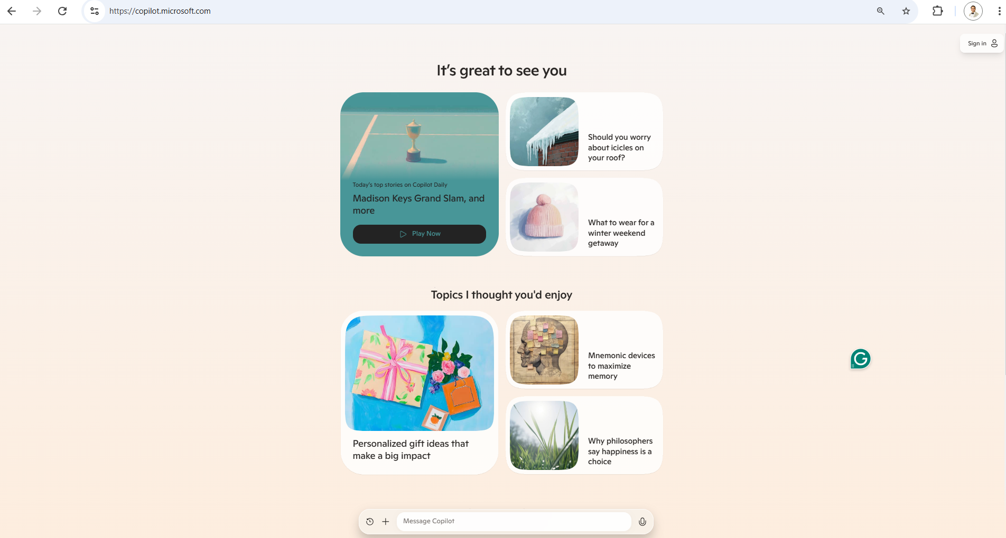
Demo
🔗 Click here to explore CoPilot CoPilot Signup
💡 Click here for AI Prompts Explore Prompts
© All rights reserved for Dr. Ryan Ahmed @Stemplicity Inc.

Slide 9
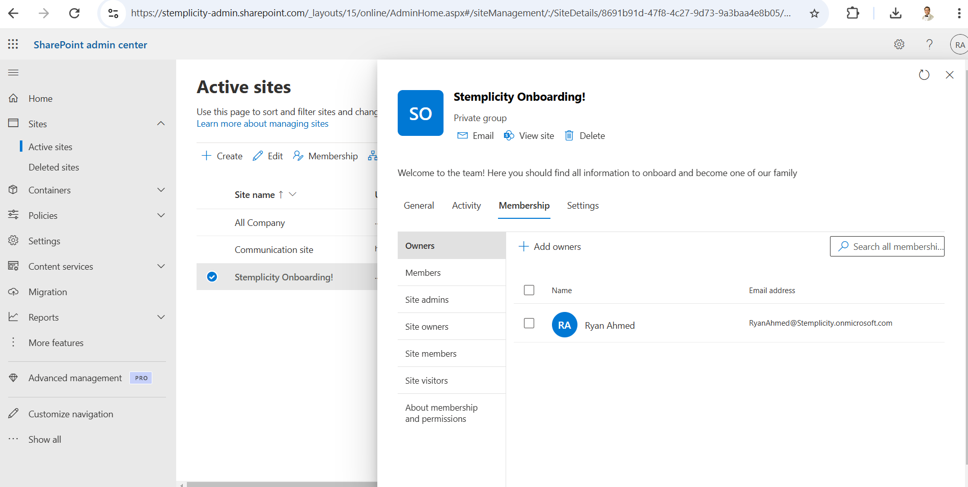
Live Demo
© All rights reserved for Dr. Ryan Ahmed @Stemplicity Inc.

Slide 10
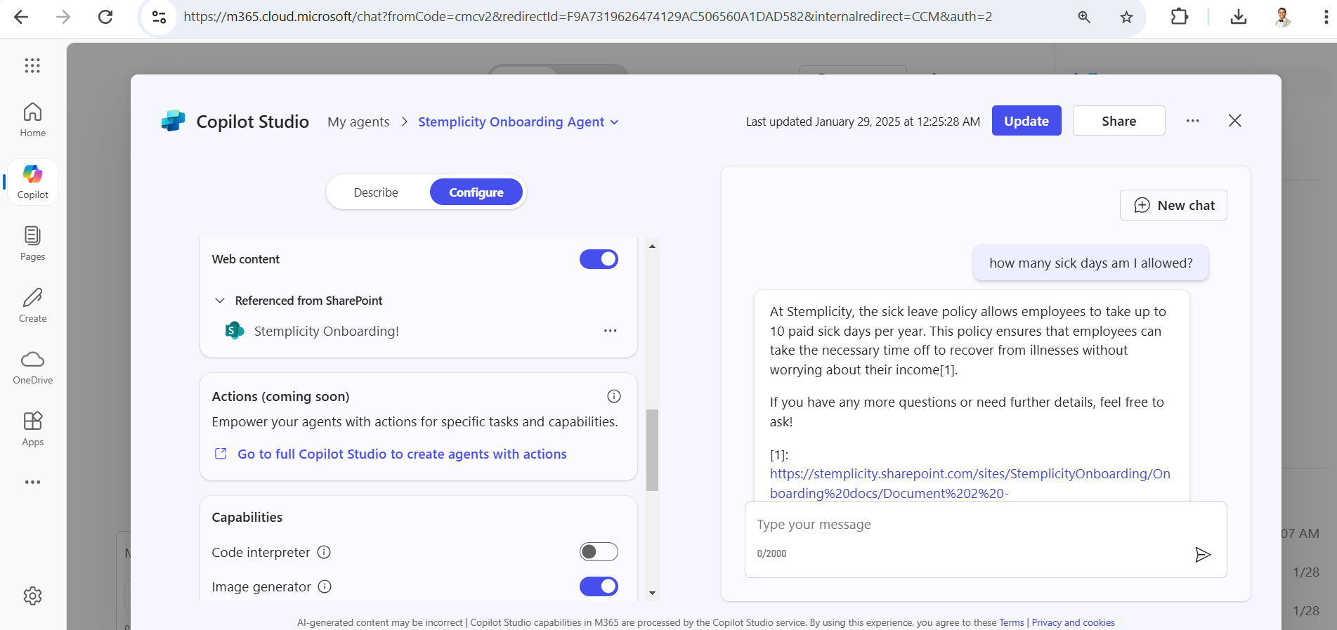
Live Demo
© All rights reserved for Dr. Ryan Ahmed @Stemplicity Inc.

Slide 11
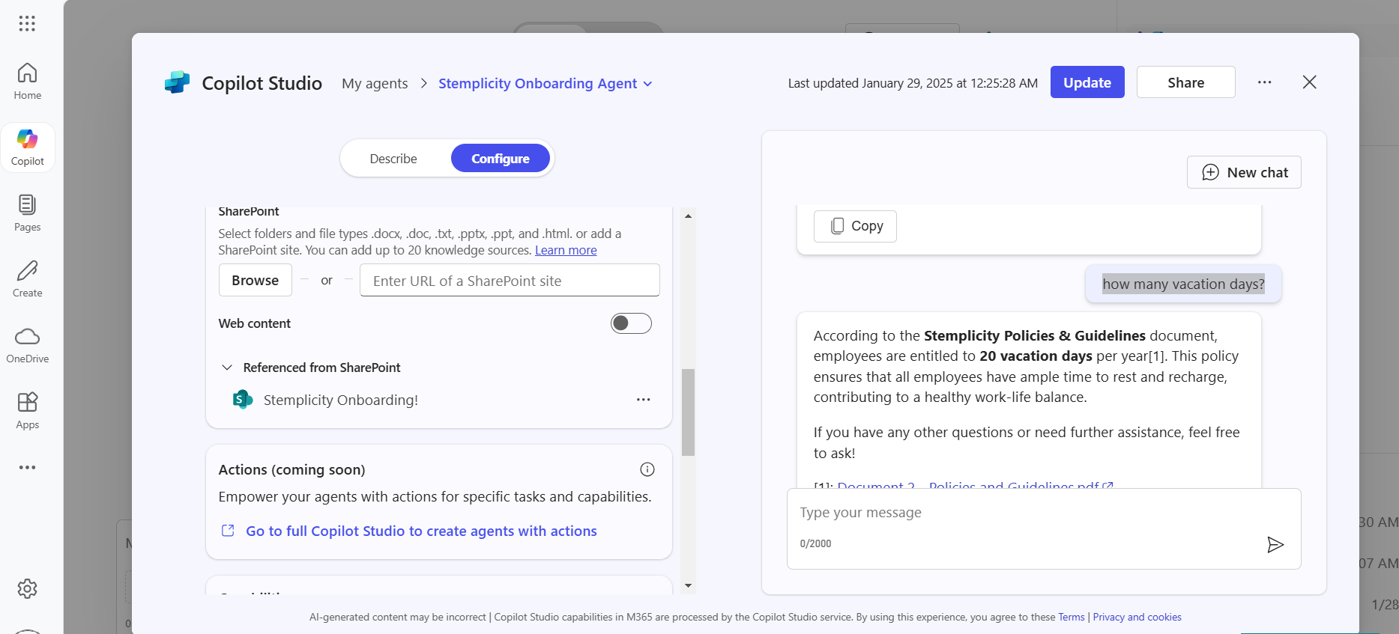
Live Demo
© All rights reserved for Dr. Ryan Ahmed @Stemplicity Inc.

Slide 12
Thank you!

